Slide 1
MLB Pitcher Injury Risk Analysis
Created By: Evan Haines & Chris Nicknish
May 8th, 2025

Slide 2
Motivation & Research Questions
Why are pitcher injuries a problem?
Research Questions:
Can we predict which pitchers are at higher risk of injury?
Which variables are most predictive of injury risk?
How effective are classification models in identifying injury risk?
Can these insights inform coaching or workload management decisions?"

Slide 3
Data Overview
Source: Statcast, Baseball Savant, Pro Sports Transactions
Timeframe: 2021–2024
Features Imported: innings pitched, velocity, pitch types, games played, etc.
Total data: 459x104

Slide 4
Data Preparation
Dropping non-numeric columns
Handling missing values (e.g., using 0s for pitch types not thrown)
Creating Binary [‘Injured’] column
Target variable distribution 0 - 58% | 1 - 42%
Standardization
Train/validation/test split: 60/20/20

Slide 5
Modeling Approach
Logistic Regression
L2 with Cross validation (C of 1)
Decision Tree
Max_Depth = 5, Min_Leaves = 5, Min_Split = 10, Criterion = Entropy
XGBoost
Eval_Metric = Logloss

Slide 6
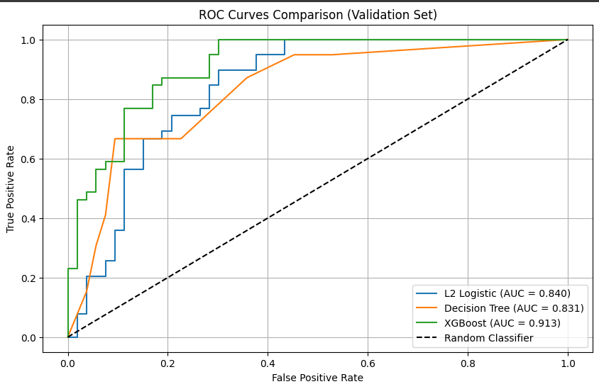
Model Performance Comparison

Slide 7
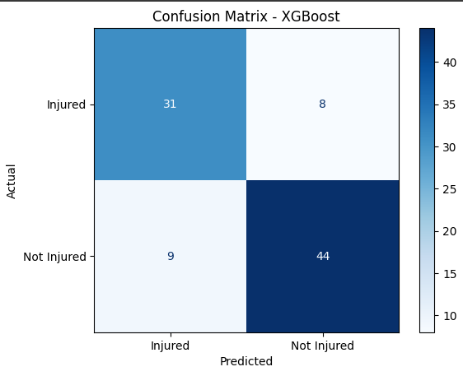
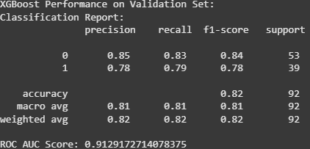
Model Evaluation

Slide 8
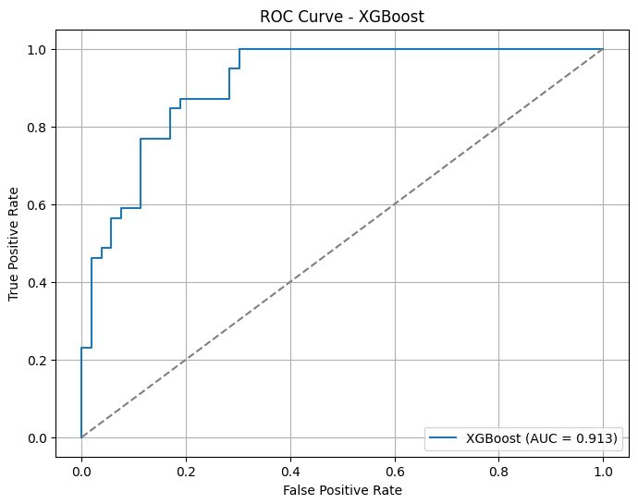
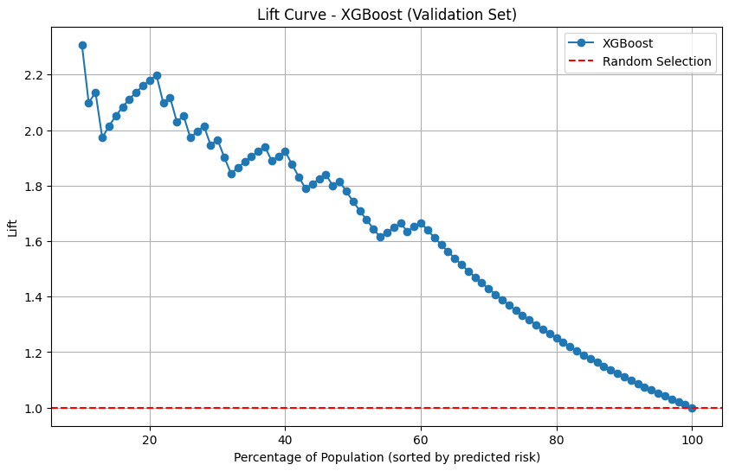
Model Evaluation
Lift curve, top 10% performed 2.31x better

Slide 9
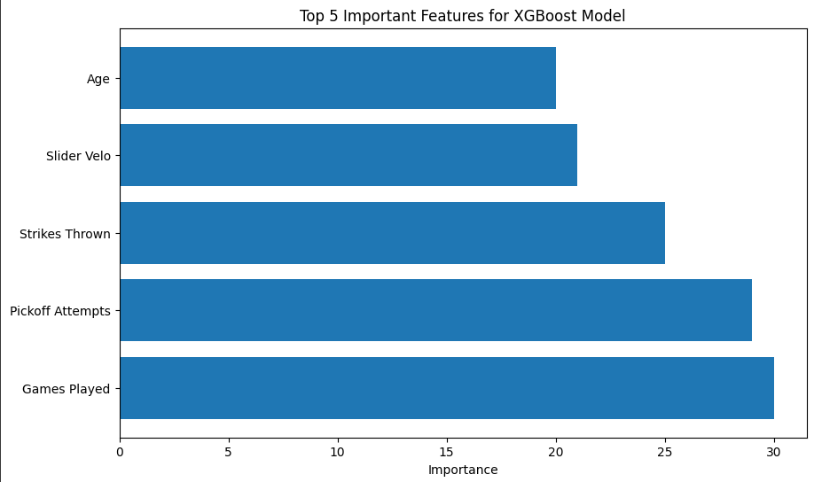
Feature Importance

Slide 10
Recommendations
Monitor
Monitor high-velocity pitchers with limited rest
Train
Train pitchers on pickoff mechanics and usage timing
Rest
Rest pitchers who use deceptive arm angles or rely on sliders

Slide 11
Questions?

